Slide 1
Pfizer Vaccine Tweets: A Sentiment Analysis
Justin Ehly, Nicole Norelli, and Mingyang Nick YU

Slide 2
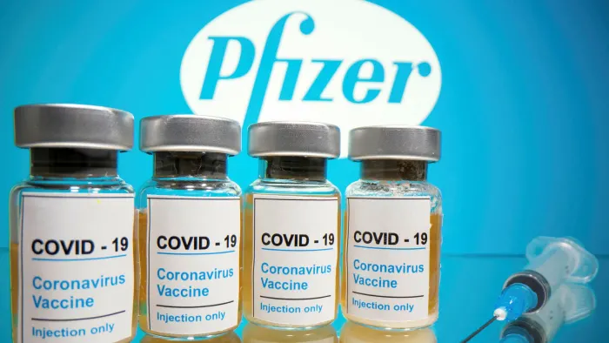
Contents
Project Overview/ Abstract
Data Description
Sentiment Analysis
Data Analysis
Conclusions
Limitations and Future Directions

Slide 3
Project Overview
Sentiment Analysis of Tweets using
#PfizerBioNTech hashtag
Location Information
Date Range: December 12, 2020 – March 13, 2021
Dataset – Kaggle/ CDC/ US Census/ World Cities/ World Countries/ US States
Data Cleaning/ EDA - R
Sentiment Analysis: Amazon S3 + Amazon Comprehend NLP
Data Visualization/ Conclusions - R

Slide 4
Procedure
Data Step
Date Collection
NLP Sentiment
Amazon Comprehend Analysis
Merge & Present
Visualizations
Clean
Twitter (Kaggle)
CDC
US Census
AWS S3
Inference & Hypothesis
Location data
Merge Various Datasets
EDA
Notes:
List all of the steps used in completing your experiment.
Remember to number your steps.

Slide 5
Data
16 variables
Ex: user_name, user_location, user_followers, date, text (tweet), hashtags, retweets (num)
6,821 tweets total
12/12/20 - 1/20/21: 4,139 tweets
1/21/21 - 3/13/21: 2,682 tweets
Missing Data: user_description (427), user_location (1381), hashtags (1676)
Geographic Variables:

Slide 6
Location Extraction
Worlds Cities
Descending string order
World Countries
U.S. States
Match Entire State Names
Only modify ones has not fixed
Match City names
Fix Country columns
Match Country Names
Small City names with high frequency - special case
Match City, State Code format
Special Cases
NYC
USA
US
Fictional Names
EARTH
GLOBAL
Etc.
Notes:
List all of the steps used in completing your experiment.
Remember to number your steps.

Slide 7
Sentiment Analysis
Utilize Cleaned tweets text (remove urls and end of line symbols)
S3 (upload/ download)
Amazon Comprehend: Natural Language Processing to determine emotional sentiment
Likelihood score for each document
Pos + Neg + Neu + Mixed = 1
Each tweet is considered its own document (charge/ document)
Merge Sentiment Analysis/Scores with each tweets

Slide 8
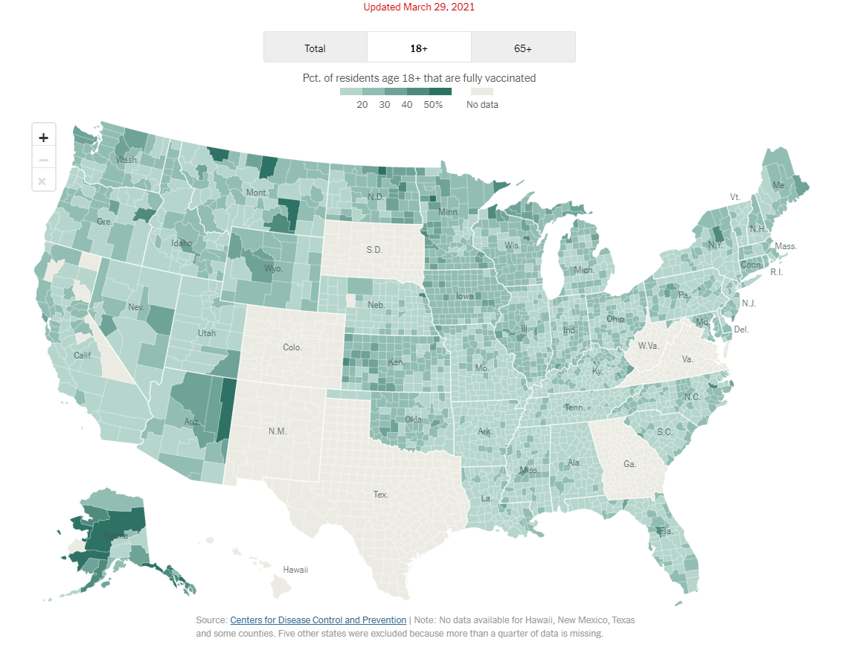
Data Analysis: Geographic Trends
Tweet by Location
Country
State
City
Notes:
Locations are user identified
Large amount of missing/fictional location
Only recovered U.S. State Info for the the full data set
Image Source: https://www.nytimes.com/interactive/2020/us/covid-19-vaccine-doses.html

Slide 9
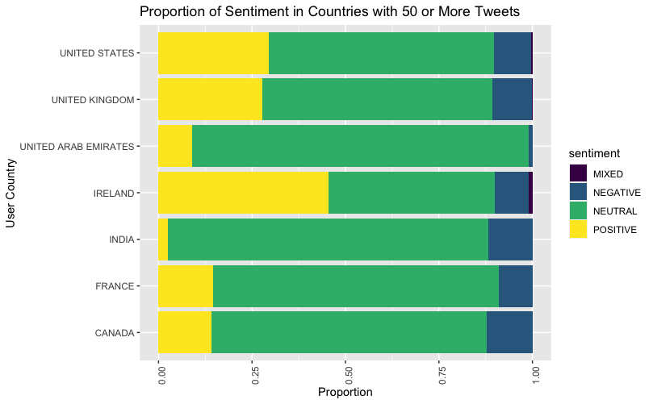
By Country
Only examined countries with 10+ tweets
No Positive Sentiment:
Cyprus, Denmark, Japan, Niger, Philippines, Qatar, Turkey, and Venezuela
Each between 11-43 tweets
Highest Proportion Positive: Ireland
Lowest Proportion Positive: India
Lowest Proportion Negative: UAE
No larger pattern of sentiment by country

Slide 10
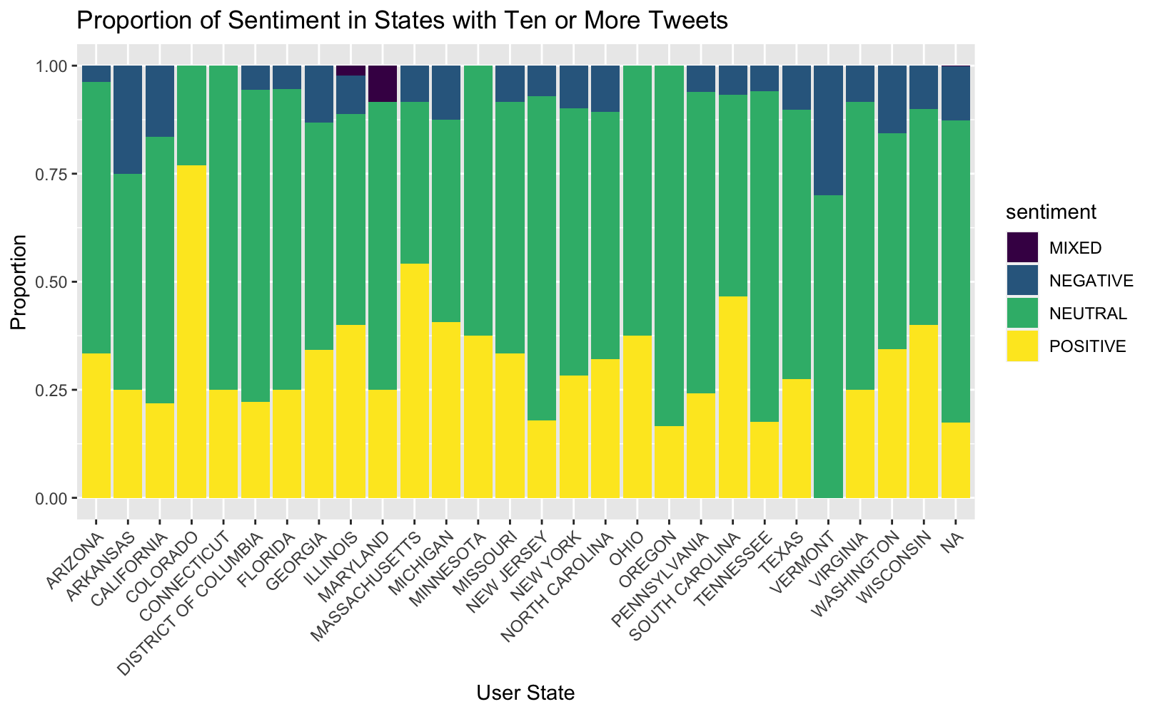
By State
953 tweets identified by state.
States 10+ Tweets:
Highest Positive: CO
Variety of users
Several identified as medical professionals
No Positive: Vermont
Most tweets from a single user
Examined COVID-19 case numbers by state over time period
No meaningful relationships between average case numbers (high/low) and state sentiment trends

Slide 11
U.S. Census Region
Small sample size of tweets in many states
4 regions:
Midwest, North East, South, West
Slightly higher positive sentiment in Midwest
Slightly higher negative sentiment in West

Slide 12
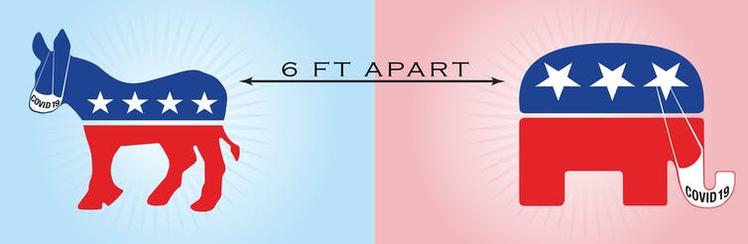
By Political Party
Democrats skew slightly more Negative
Republicans skew slightly more Positive
Individuals tweeting may not identify with majority politically
Image Source: https://theconversation.com/coronavirus-new-survey-shows-how-republicans-and-democrats-are-responding-differently-138394

Slide 13
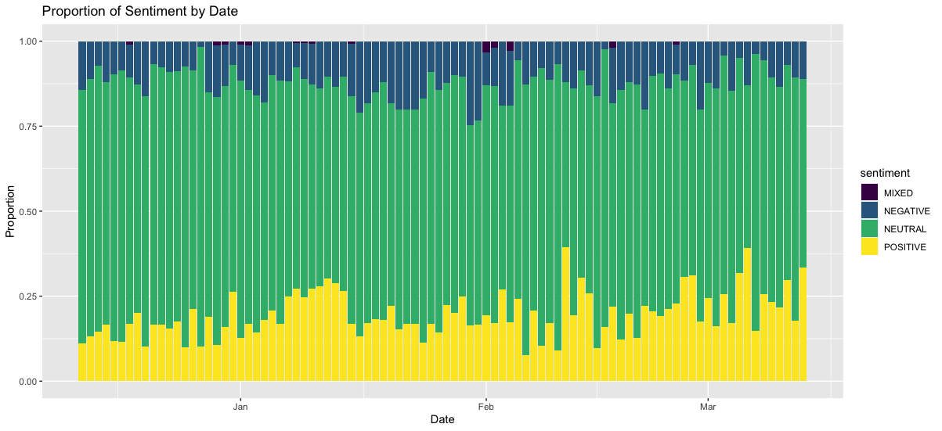
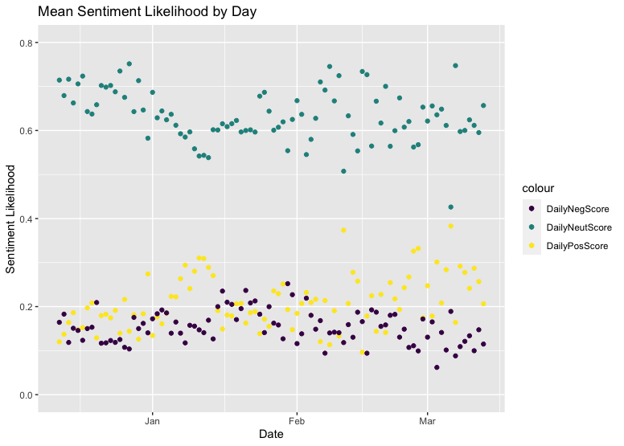
Sentiment Over Time
Expectation: polarization
Reality:
Increase in Positive Sentiment
Decrease in Negative Sentiment
Decrease in Neutral Sentiment

Slide 14
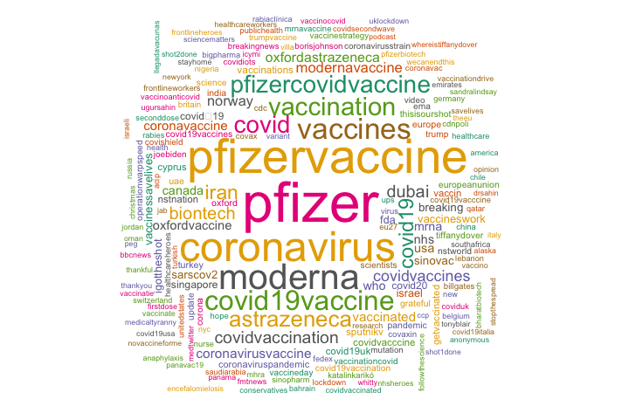
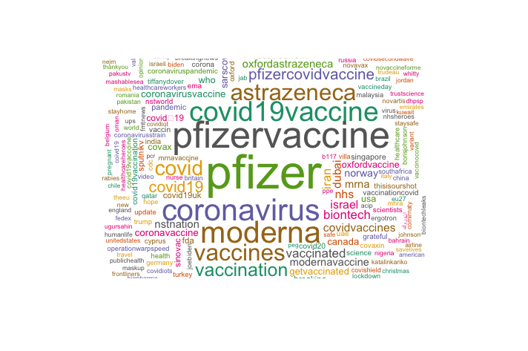
High frequency Hashtags over time
01-21-21
03-15-21

Slide 15
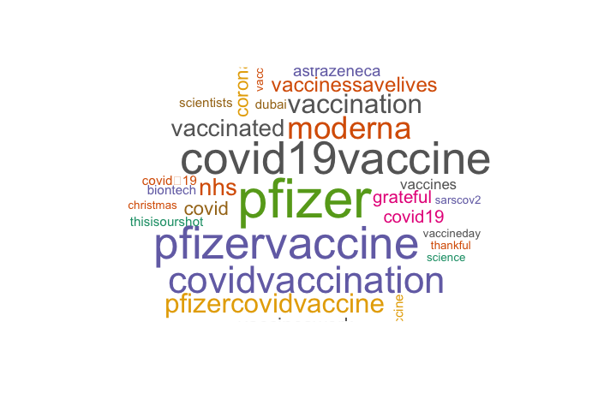
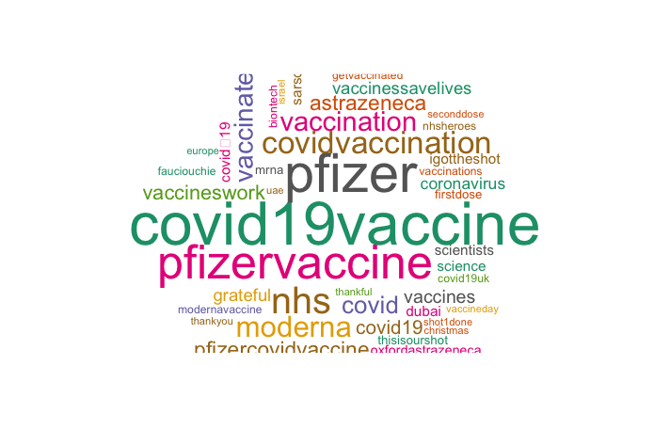
Positive Sen Hashtags over time
01-21-21
03-15-21

Slide 16
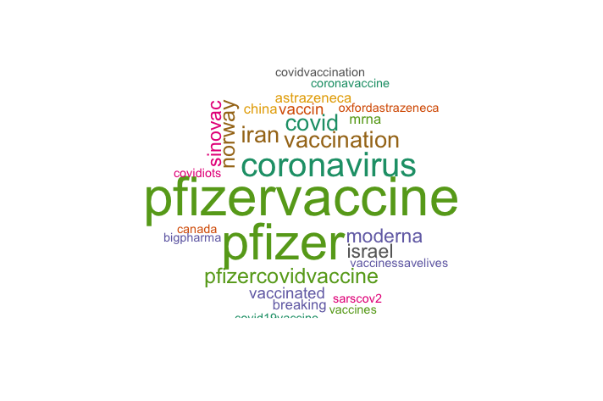
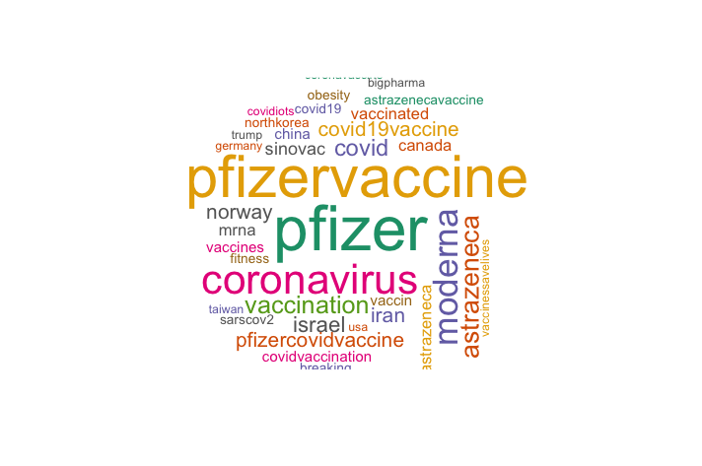
Negative Sen Hashtags over time
01-21-21
03-15-21

Slide 17
Positive vs. Negative Sentiment
Negative
Positive

Slide 18
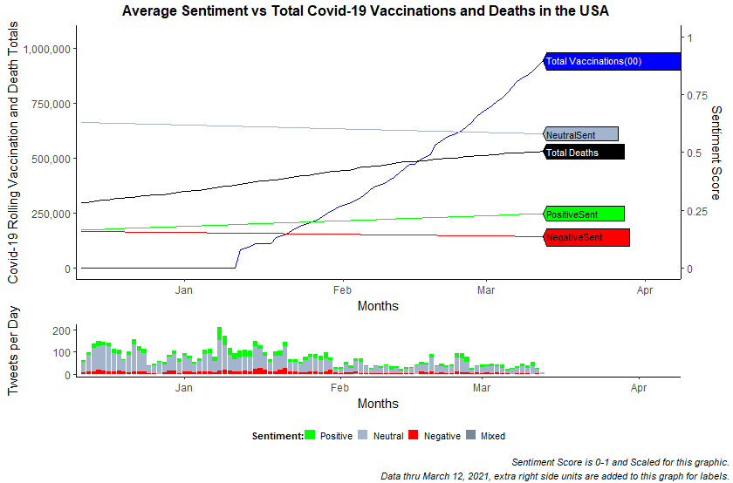
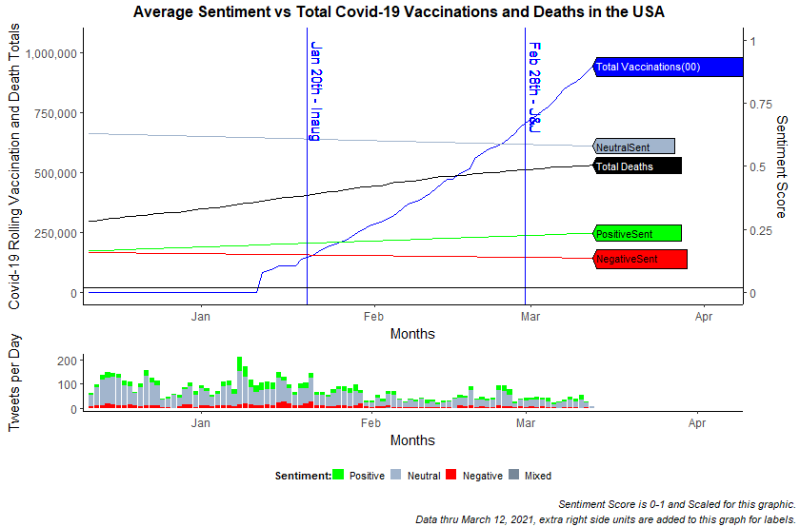
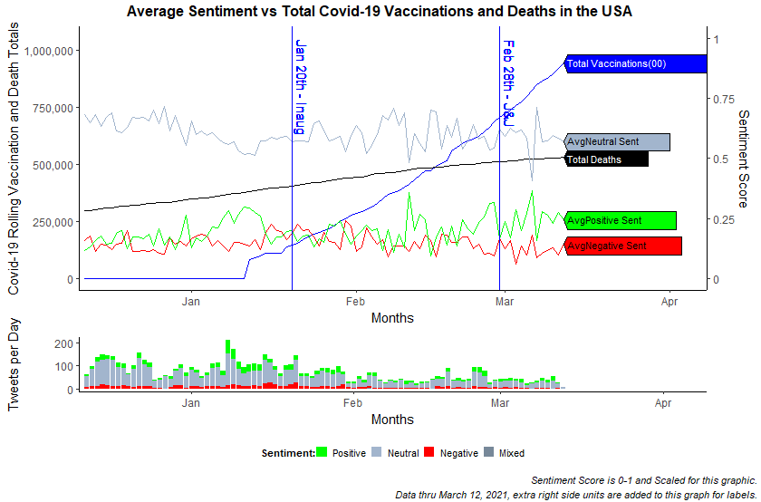
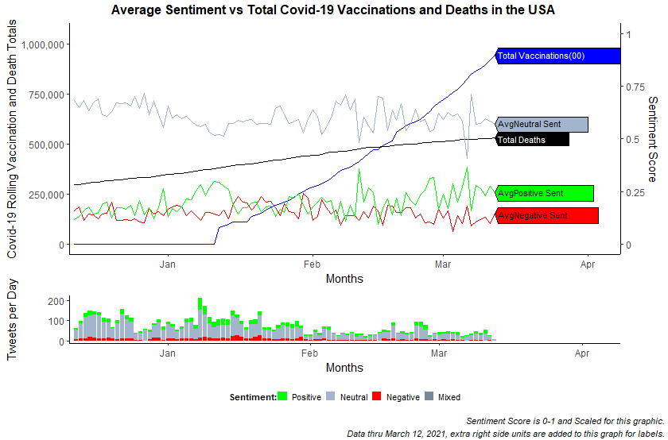
Conclusion
Increase in Positive Sentiment over time
Decrease in Neutral and Negative Sentiment over time
Decrease in volume of Tweets
Waning public interest
Increase of vaccine availability
Change in governmental messaging

Slide 19
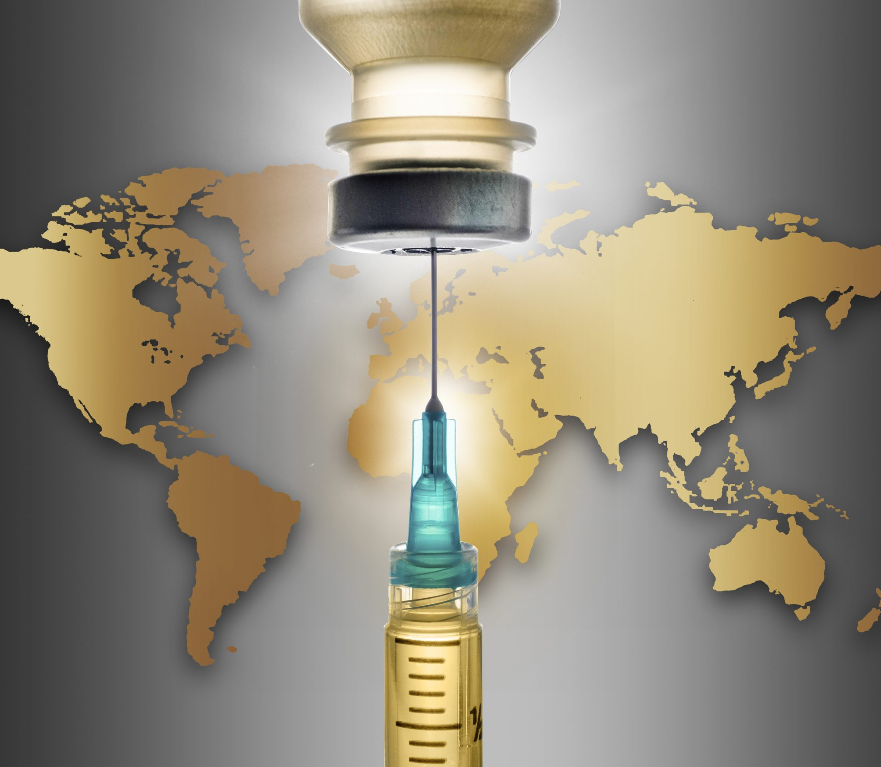
Limitations & Future Directions
Self-reporting across Twitter limits location reporting
Expand analysis to real-time framework
Expand #hashtags to be more inclusive of all Covid-19 Vaccination Variants
Expand to include additional languages
Image Source: https://blogs.microsoft.com/blog/2020/12/11/successful-covid-19-vaccine-delivery-requires-strong-tech-partnerships/

Slide 20
Works Cited
Loomba, S., de Figueiredo, A., Piatek, S.J. et al. Measuring the impact of COVID-19 vaccine misinformation on vaccination intent in the UK and USA. Nat Hum Behav (2021). https://doi.org/10.1038/s41562-021-01056-1
de Figueiredo, A., Simas, C., Karafillakis, E., Paterson, P. & Larson, H. J. Mapping global trends in vaccine confidence and investigating barriers to vaccine uptake: a large-scale retrospective temporal modelling study. Lancet 396, 898–908 (2020).
Kim, H. K., Ahn, J., Atkinson, L. & Kahlor, L. A. Effects of COVID-19misinformation on information seeking, avoidance, and processing: a multicountry comparative study. Sci Commun 42, https://doi. org/10.1177/1075547020959670 (2020).
Schmidt, A. L., Zollo, F., Scala, A., Betsch, C. & Quattrociocchi, W. Polarization of the vaccination debate on Facebook. Vaccine 36, 3606–3612 (2018).
KFF Health Tracking Poll/ KFF COVID-19 Vaccine Monitor (February 15-23, 2021)

